Slide 1
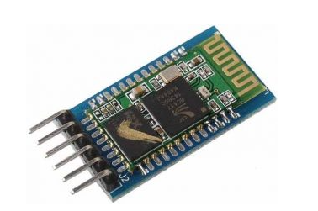
Interfacing Arduino with HC-05 Bluetooth Module

Slide 2
HC-05 Bluetooth Module Lab
In this Arduino Bluetooth lab, we will learn how use the HC-05 module for controlling Arduino via Bluetooth communication.
The HC-05 module is a Bluetooth SPP (Serial Port Protocol) module, which means it communicates with the Arduino via the Serial Communication.
Designed to replace cable connections.

Slide 3
Components Required
Arduino UNO/Mega
HC-05 Bluetooth Module
Resistor 1K/2K
Bread Board/Jump Wires
5mm LED

Slide 4
What is HC-05 Bluetooth Module?
The Bluetooth module is a device which is used for short range wireless communication to the respective connected device.
The HC-05 module is a Bluetooth SPP (Serial Port Protocol) module, which means it communicates with the Arduino via the Serial Communication.
Two configurations that are master and slave. In short, the device control other devices in master mode and in slave mode the device is being controlled by some other device.

Slide 5
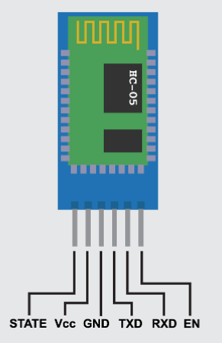
What is HC-05 Bluetooth Module?
This module can connect the devices in the range of 10 meters of the Bluetooth and it works on the 2.4GHz frequency band. The Bluetooth module operates on the voltage ranging from 3.3 volts to 5 volts and has 6 pins in total.

Slide 6
Pin Configuration
(EN) - Pin for using the Bluetooth in command mode by setting the baud rate 38400 and giving this pin HIGH state. By default, the module is in the data mode, so this pin has a LOW state.
(VCC) - Pin for giving supply to the Bluetooth module that is 5 or 3.3 volts.
(GND) - Pin used to ground the Bluetooth module.

Slide 7
Pin Configuration
(TXD) - Pin used for transferring the data through Serial communication
(RXD) - Pin used for receiving the data through serial communication.
(STATE) - To check whether the module is connected or not this pin is mainly used.

Slide 8
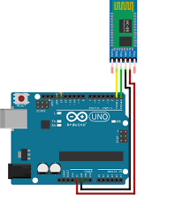
Schematic Diagram of HC-05 Bluetooth Module

Slide 9
Schematic Diagram of HC-05 Bluetooth Module
First, the connections are important. There are 6 pins on the bluetooth module. For this project, we will only need to use the middle 4 pins.
HC-05 --> Arduino
RX --> TX
TX --> RX
GND --> GND
VCC --> 5v

Slide 10
Schematic Diagram of HC-05 Bluetooth Module
In order to play it safe though, it is important to first connect RX to a resistor, and then to TX on the Arduino. Then, connect RX to another resistor, then to GND.
The GND from the HC-05 will connect to this resistor, and then will go to GND on the Arduino. So, both the RX and the GND of HC-05 go to GND of Arduino. This will ensure that there is no failure of components.

Slide 11
Schematic Diagram of HC-05 Bluetooth Module
However, since we are using a breakout board(which has an in-built voltage-regulator), there will be no issues at all, even if you do not follow that schematic described.
This is called a voltage divider circuit, which divides voltage, acting like a resistor. The image in next slide is the schematic of it. It is shown using an Arduino mega, though it is applicable for the Arduino Uno too.

Slide 12
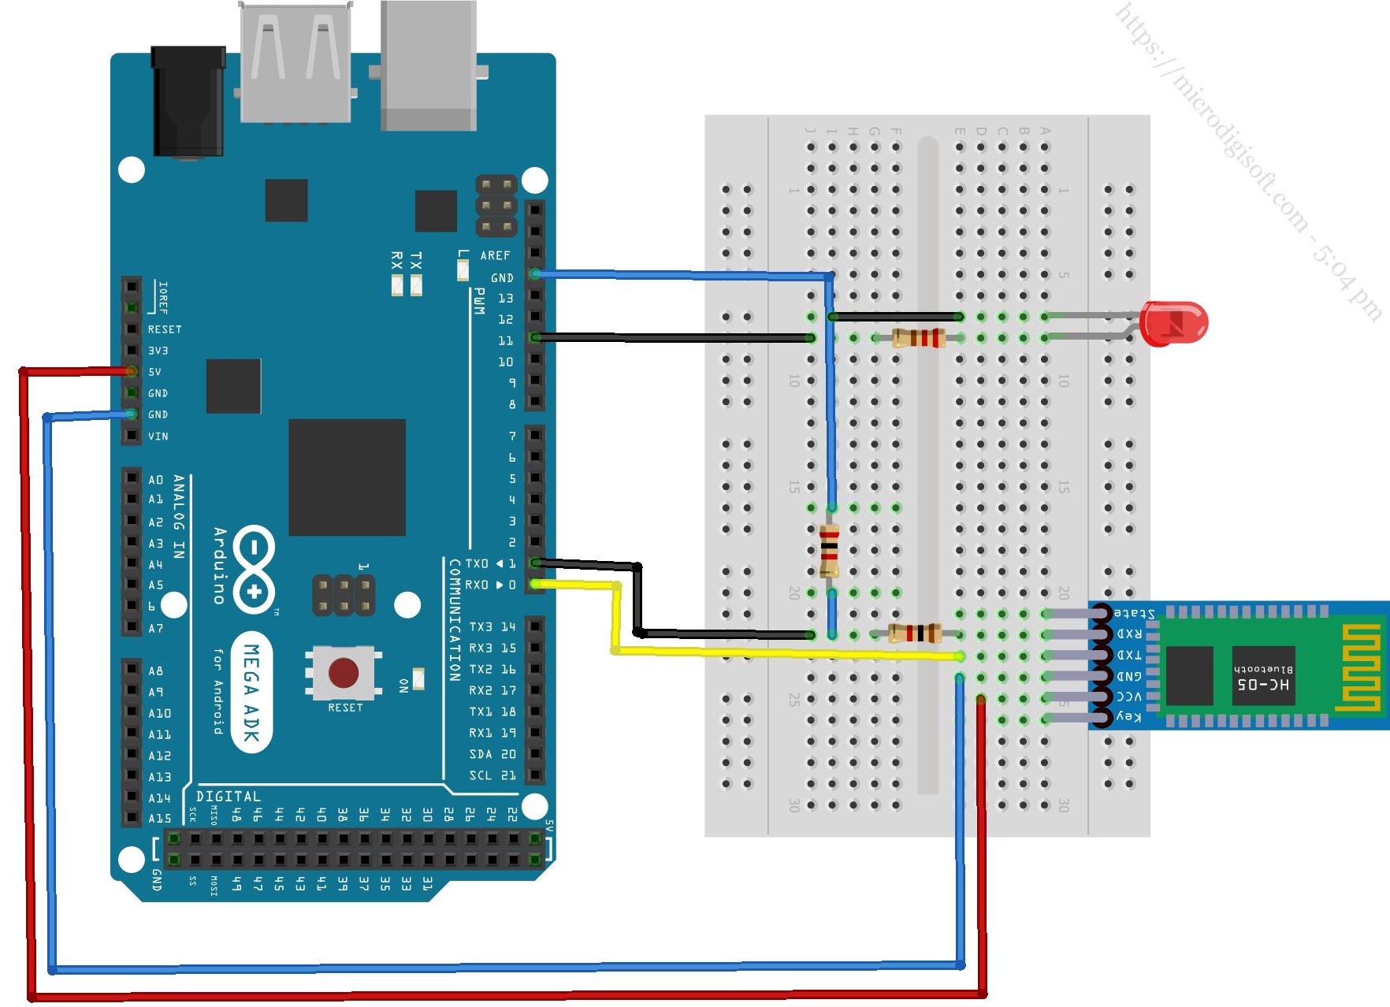
Schematic Diagram of HC-05 Bluetooth Module

Slide 13
Schematic Diagram of HC-05 Bluetooth Module with voltage divider circuit
HC-05 --> Arduino
RX --> TX
RX --> GND
TX --> RX
GND --> GND
VCC --> 5v

Slide 14
Schematic Diagram of HC-05 Bluetooth Module with LED
LED --> Arduino
Positive leg(Long leg) --> Any pin you like
Negative leg(Short leg) --> GND

Slide 15
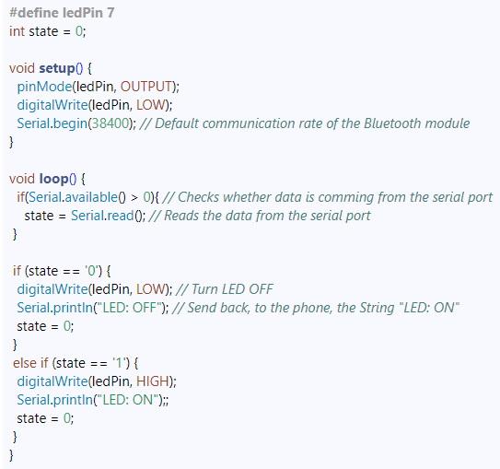
Source Code For HC05 Bluetooth Module to turn an LED Off or On

Slide 16
Code description
Define the pin to which the LED will be connected and a variable to store data.
In the setup section, define the LED pin as output and set it low, begin serial communication at 38400 baud rate.
In the loop section, check for available data in the serial port using Serial.available() function, read data and put it in the "state" variable.

Slide 17
Code description
If the Arduino receives character '0', turn off the LED, send back "LED: OFF" via serial port and reset "state" variable to 0.
If the Arduino receives character '1', turn on the LED, send back "LED: ON" via serial port.

Slide 18
Connecting the Smartphone to the HC-05 Bluetooth Module and the Arduino
We need to do here is to activate the Bluetooth and the smartphone will find the HC-05 Bluetooth module.
Then we need to pair the devices and the default password of the HC-05 module is 1234. After we have paired the devices we need an application for controlling the Arduino.
There a lot of Apps available to work with Arduino or we can create our own using MIT App Inventor online application. Here we will use a pre-built app.

Slide 19
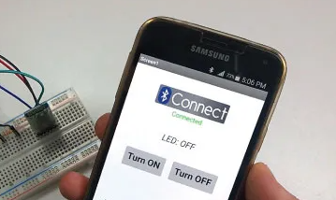
Connecting the Smartphone to the HC-05 Bluetooth Module and the Arduino

Slide 20
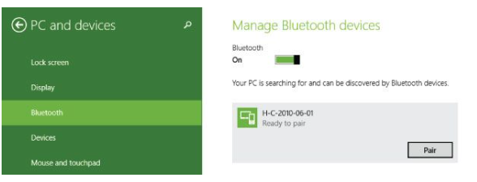
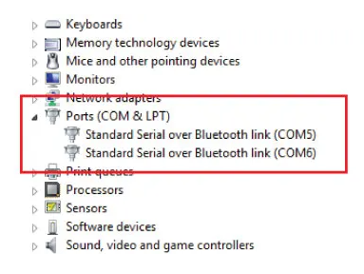
Controlling Arduino Using a Laptop or PC via Bluetooth Communication

Slide 21
Controlling Arduino Using a Laptop or PC via Bluetooth Communication
We need to pair our laptop to the HC-05 Bluetooth module and we can do that from the Laptop Bluetooth Settings. The laptop will discover the HC-05 module and using the ‘1234’ password we will pair the devices.
Once we will pair the devices in the Laptop Device Manager, under Ports (COM & LPT), two new entities will appear named “Standard Serial over Bluetooth link”. From here we can see the COM Port number of the serial port through which the devices will communicate.

Slide 22
Controlling Arduino Using a Laptop or PC via Bluetooth Communication
We will stick with the same example as previously, turning on and off a LED and sending back a string to the laptop, so we will use the same Arduino code as previously described.
Now using the Processing IDE we will make a program for controlling the Arduino.

Slide 23
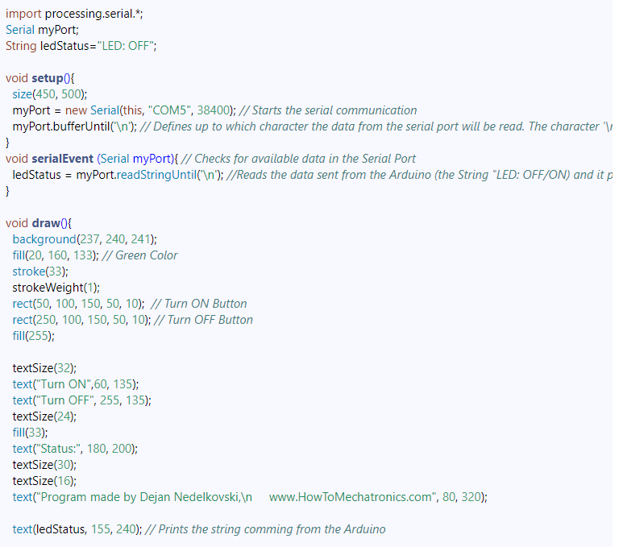
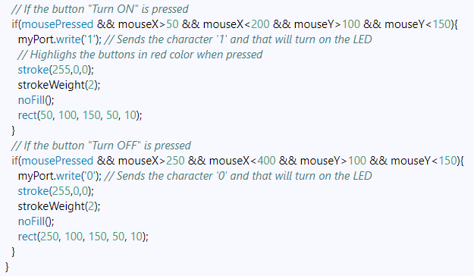
Processing IDE Source Code

Slide 24
Processing IDE Source Code Explanation
Include the Serial library and create a serial object to enable serial communication
Define a String variable for the led status
In the setup section, set the window size of the program and start the serial communication, try one of the two COM Port numbers previously noted in the device manager
Define the buffering of the serial port, in this case until there is a new line
Using the serialEvent() function, check for available data in the serial port and read it using the readStringUntil() function
In the main draw() function, set the background color, fill color, stroke size and color, draw the two buttons and print all the text, including the ledStatus string
Make the buttons functional by confining the area of the "Turn ON" button, sending the character '1' over the serial port to turn on the LED and highlighting the button when it's pressed. Repeat this process for the "Turn OFF" button.

Slide 25
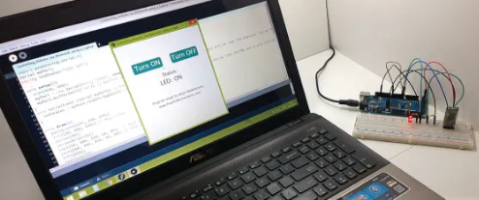
Processing IDE Source Code Explanation
Now the program is ready, so when we will click the run button, the program will automatically activate the Bluetooth communication between the laptop and the Arduino. The HC-05 Bluetooth module will start to flash every two seconds, which indicates that the module is connect and we will be able to control the LED using our Laptop.

Slide 26
Conclusion
The lab on interfacing the HC-05 Bluetooth module with Arduino was a valuable learning experience in which students gain hands-on experience with programming the Arduino, as well as understanding how serial communication works. The students were able to control an LED via a smartphone, showing the potential applications of the technology. The lab helped students understand the importance of communication protocols and how to implement them in real-world scenarios.

Slide 27
Q&As

